Slide 1
How to combine two subject areas in an Alma Analytics report
Yoel Kortick – Senior Librarian

Slide 2

Contents
  Terminology
  Example – what are we trying to achieve?
  Steps to create the report
  View results

Slide 3

Terminology

Slide 4
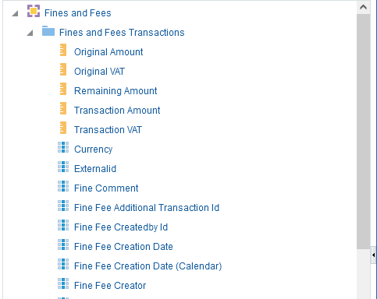
Terminology
Fact.
Typically, the fact is the first folder and is the only folder which includes measures
Subject area
Measures.
Have yellow rectangle at beginning
Attributes.
Fields which have a descriptive value.

Slide 5
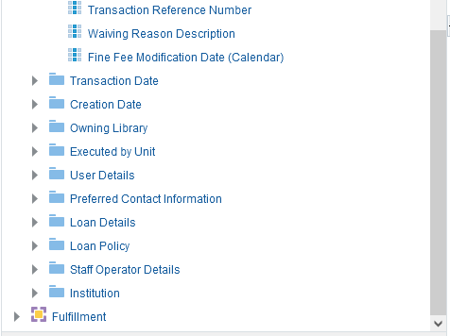
Terminology
Dimensions.
Typically, dimensions are not the first folder. Typically, they include only attributes and not measures.
Subject area

Slide 6


Introduction

Slide 7
Introduction
In order to be able to join two subject areas the following three conditions must be met:
  There must be at least one common dimension among the two subject areas
  Descriptive fields must come from the common dimension(s)
  Measures will come from the facts
The above will become clear throughout the presentation and example.

Slide 8

Example – what are we trying to achieve?

Slide 9
Example – what are we trying to achieve?
We want to create a report which will include information from the "Loan Details" and "Loan Policy" dimensions (folders) which are in both the "Fulfillment" subject area and the "Fines and Fees" subject area.
We also want to include
  The "Loans (Not In House)" and "Loan Days" measures which are in the "Loan" fact of the "Fulfillment" subject area
  The "Transaction Amount" measure which is in the "Fines and Fees Transactions" fact of the "Fines and Fees" subject area.

Slide 10
Example – what are we trying to achieve?
What is the "issue"?
If we make the report in the "Fulfillment" subject area, then we will be missing the "Transaction Amount" which is in the "Fines and Fees Transactions" fact of the "Fines and Fees" subject area.
If we make the report in the "Fines and Fees" subject area, then we will be missing the "Loans (Not In House)" and "Loan Days" field which are in the "Loan" fact of the "Fulfillment" subject area

Slide 11
Example – what are we trying to achieve?
We will therefore combine the two different subject areas:
  Fulfillment
  Fines and Fees
The common dimensions are:
  Loan Details
  Loan Policy

Slide 12
Example – what are we trying to achieve?
Here we will reiterate: the reason we want to combine subject areas is because we want information from both of the subject areas.
We want our report to include:
  "Transaction Amount" from "Fines and Fees" subject area .
  "Loans (Not In House)" and "Loan Days" from the "Fulfillment" subject area.

Slide 13


Steps to create the report

Slide 14
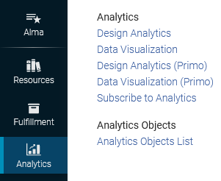
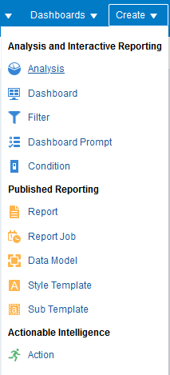
Steps to create the report
Step 1
Enter Alma Analytics and create new analysis

Slide 15
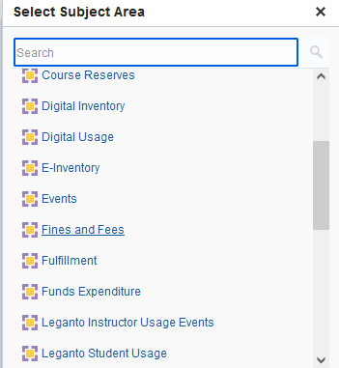
Steps to create the report
Step 2
Select one of the two subject areas you wish to combine
First we will choose "Fines and Fees"

Slide 16
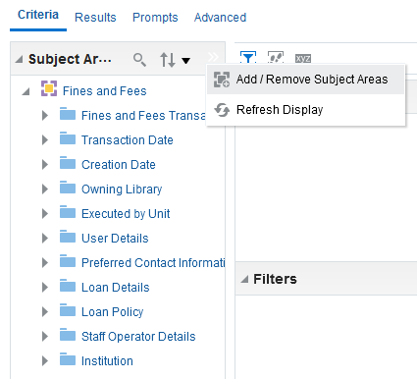
Steps to create the report
Step 3
Select "Add / Remove Subject Areas"

Slide 17
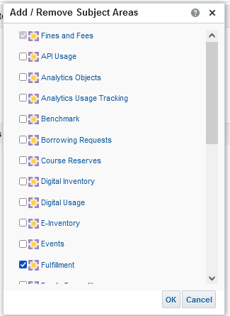
Steps to create the report
Step 4a
Select the second desired "subject area"
We already chose "Fines and Fees"
Now we choose "Fulfillment"

Slide 18
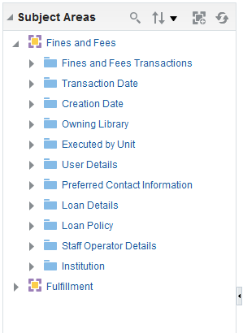
Steps to create the report
Step 4b
Now we have both subject areas

Slide 19
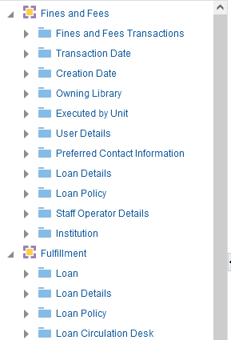
Steps to create the report
Step 5
Take note of common and non-common dimensions in each subject area
Fact
Non-common dimensions
"Loan Details" and "Loan Policy" are common dimensions to both subject areas
Fact
Non-common dimensions

Slide 20
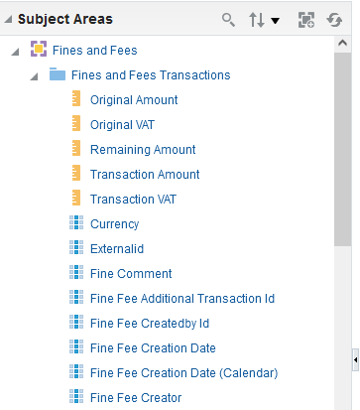
Steps to create the report
Step 6
Take note of which fields are measures
Any field with a yellow rectangle at the beginning is a measure. Measures are typically located only in facts. Facts are typically the first in the list.

Slide 21
Steps to create the report
Step 7
Add columns (fields) to the report
We will now add the fields which we want to display and / or filter on in the report
As stated in the beginning of this presentation we can add:
All fields which are measures
Fields which belong to common dimensions (in this case all fields under dimensions "Loan Details" and "Loan Policy")

Slide 22
Steps to create the report
Step 7
Add columns (fields) to the report
Fields from fact "Loan" come from the "Fulfillment" subject area. Fields "Loans (Not In House)" and "Loan Days" are measures.
Fields from dimension "Loan Details" and "Loan Policy" are descriptive and come from common dimensions present in both subject areas
Fields from fact "Fines and Fees Transactions" come from the "Fines and Fees" subject area. Field "Transaction Amount" is a measure.

Slide 23

View Results

Slide 24
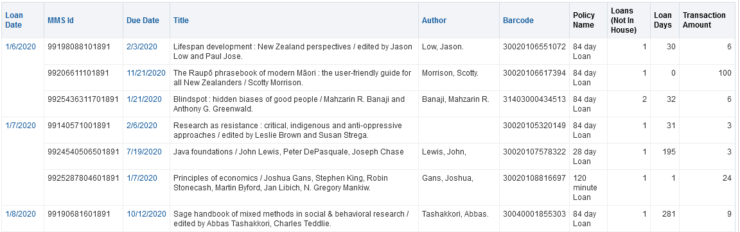
View results
Measures from fact "Loan" in the "Fulfillment" subject area
Measure from fact "Fines and Fees Transactions" in the "Fines and Fees" subject area.
Fields from dimension "Loan Details" and "Loan Policy" which are common dimensions present in both subject areas
These three measures come from two different subject areas.

Slide 25
xxx@exlibrisgroup.com

